Slide 1
OOP
Recursion & Files
Notes:
A Bayley

Slide 2
Recursion
Recursion in java is a process in which a method calls itself repeatedly. A method in java that calls itself is called recursive method. It makes the code compact but complex to understand.
A real world example- a comma-separated list of numbers: 32, 42, 52, 62, which can be defined as:
a LIST is a: number
or a: number comma LIST
That is, a LIST is defined to be a single number, or a number followed by a comma followed by a LIST
Notes:
A Bayley

Slide 3
Recursive void Methods
A recursive method is a method that includes a call to itself
Recursion is based on the general problem solving technique of breaking down a task into subtasks
In particular, recursion can be used whenever one subtask is a smaller version of the original task
Before applying recursion to programming, it is best to practice thinking recursively

Slide 4
General Form of a Recursive Method
The general outline of a successful recursive method definition is as follows:
  One or more cases that include one or more recursive calls: "smaller" versions of the task performed by the method
  Base case: One or more cases that include no recursive calls, or stopping cases

Slide 5
Example
Calculating the factorial of an integer:
n!=n×(n−1)×(n−2)×…×2×1
The recursive way to look at the factorial problem is to realize that the factorial for any given number n is equal to n times the factorial of n–1, provided that n is greater than 1. If n is 1, the factorial of n is 1
    public static long factorial(int n) {
    if (n == 1) return 1;
    else return n * factorial(n-1);
    }

Slide 6
Infinite Recursion
The series of recursive calls eventually have to reach a call of the method that did not involve recursion (a stopping case)
If they didn't, there would be no way to terminate the recursive path
Such a definition would cause infinite recursion
In practice, such a method runs until the computer runs out of resources, and the program terminates abnormally

Slide 7
Recursion vs Iteration
Recursion is not absolutely necessary. Any task that can be done using recursion can also be done in a non-recursive manner
A non-recursive version of a method is called an iterative version
An iteratively written method will typically use loops of some sort in place of recursion
A recursively written method can be simpler, but will usually run slower and use more storage than an equivalent iterative version

Slide 8
OOP
Files
Notes:
A Bayley

Slide 9
Why use Files?
The data in programs written so far has either been:
  hard-coded into the program
  read from the keyboard (using Scanner)
The results from programs written so far has been:
  written to console window
It can be more useful to: Read data from a file and write data to a file
      In order to save data between program executions and restore interface data back to it’s current state.
int width = 4;
Scanner kybd = new Scanner(System.in);
width = kybd.nextInt();
System.out.println("Hello world!");

Slide 10
Why use Files?
As we are using objects in OO we need to:
  Read object data from a file
  Saving object data to a file

Slide 11
OOP
Files
Notes:
A Bayley

Slide 12
File Basics
To use files we need to…
  Open a Connection
    Use a Class provided by the underlying system to
      Write to a new file
      Over write data in a file
      Append to the end of a file
      Read data from a file
  Close Connection
This Process is common to most languages
In Java,
java.io package provides several classes to deal with files
Notes:
A Bayley

Slide 13
Using Files in Java
must import classes from the java.io package
need to link to input or output file in code
  files can then be read from or written to
any file handling operations must be enclosed within a try…catch structure to handle any exceptions
at end of processing, all files should be closed
import java.io.*;
try
{
in.close();
}
catch (IOException ioe)
{
System.out.println("ERROR: "+ ioe.getMessage());
}

Slide 14
Java Readers, writers, streams
Classes provided by java.io package falls into 2 main categories:
  Classes to deal with text files
  Classes to deal with binary files
Java classes provided to process text files:
  Readers and Writers
Java classes provided to process binary files:
  Stream handlers
Textual files with simple
alphanumeric characters
Image files, executable files etc.

Slide 15
Writing output to a text file
Use the FileWriter class.
  Open a file.
  Write to the file.
  Close the file.
FileWriter class only contains a method to write characters
  FileWriter class contains write()method to write characters
  Augment with PrintWriter for line-based output.
  PrintWriter class defines println() to write lines
Failure at any point results in an IOException.

Slide 16
Writing characters to a file
import java.io.FileWriter;
import java.io.IOException;
...
...
try
{
FileWriter writer = new FileWriter("name of file");
while(there is more characters to write)
{
...
writer.write(next piece of text);
...
}
writer.close();
}
catch(IOException e)
{
something went wrong with accessing the file
}
If opening the file fails, throws an
IOException
Opening the file and
preparing to receive output
Stores characters in to the file.
If it fails, throws an IOException
After all data is written to the file, close it.
If it fails, throws an IOException
Notes:
A Bayley

Slide 17
Writing lines to a file
import java.io.FileWriter;
import java.io.IOException;
import java.io.PrintWriter;
...
...
...
try
{
PrintWriter writer = new PrintWriter(new FileWriter("filename"));
while(there is more text to write)
{
writer.println(line of text);
}
writer.close();
}
catch(IOException e)
{
something went wrong with accessing the file
}
Import PrintWriter class to write entire lines
Creates a FileWriter but then pass it to the
constructor of a PrintWriter Object.
if the file already exist,
its contents will be overwritten
if the file doesn't exist, a new one is created
Creates a new PrintWriter and
preparing to print lines of Strings in to the file
Stores a line in to the file.
After all data is written to the file, close it and
release any system resources
If it fails, throws an IOException
Notes:
A Bayley

Slide 18
Reading input from a file
Use the FileReader class.
  Open a file.
  Read from the file.
  Close the file.
FileReader class only contains a method to read characters
  FileReader class defines read() method to read characters
  Augment with BufferedReader for line-based input.
  BufferedReader class defines readLine() to read lines
Failure at any point results in an IOException.
Notes:
FileReader does not contain a method to read a line. The problem with reading lines from a file is that there is no predefined limit to the length of a line. This means that any method to return the next complete line from a file must be able to read an arbitrary number of
characters. For this reason, we usually need to be working with the BufferedReader class, which does define a readLine method.
A Bayley

Slide 19
Reading characters from a file
import java.io.FileReader;
import java.io.FileNotFoundException;
import java.io.IOException;
...
...
try
{
FileReader reader = new FileReader("filename.txt");
int characterRead;
while((characterRead = reader.read())!= -1)
{
do something with characterRead
}
reader.close();
}
catch(FileNotFoundException fx)
{
the specified file could not be found
}
catch(IOException io)
{
something went wrong with reading or closing
}
FileReader object is used to open the file
read() method returns
the character read (ASCII value),
or -1 if the end of the file
has been reached
Notes:
Character data is represented in a computer by using standardized numeric codes.
A Bayley

Slide 20
Reading lines from a file
FileReader object is used to open the file
try
{
BufferedReader reader =
new BufferedReader(new FileReader("File Name"));
String line = reader.readLine();
while(line != null)
{
do something with line
line = reader.readLine();
}
reader.close();
}
catch(FileNotFoundException e)
{
the specified file could not be found
}
catch(IOException e) {
something went wrong with reading or closing
}
Reads the first line of the file
ReadLine returns Null if end of file
Notes:
A Bayley

Slide 21
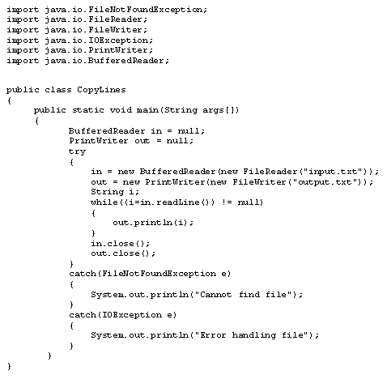
Reading and Writing lines (Strings)
Class to help read from file
Different class for writing to file
Note the addition of two new classes.
BufferedReader (reading lines as Strings)
PrintWriter (writing lines as Strings)
The error handling stuff!

Slide 22
Reading and Writing lines (Strings)
Creates a FileReader but then pass it to the constructor of a BufferedReader
Read a line of text using the BufferedReader Object
Creates a FileWriter but then pass it to the constructor of a PrintWriter Object
if the file already exist, its contents will be overwritten
if the file doesn't exist, a new one is created
Write a line of Text using the PrintWriter Object

Slide 23
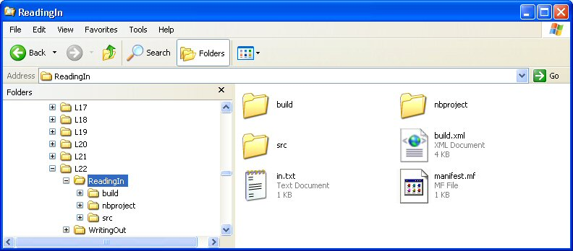
Using Scanner to Parse input files
Many applications will be dealing with structured files with individual lines of multi-types data values
Scanner class can be used to scan such data files and convert composite sequences of characters to typed values (parsing)
File name
Scanner in = new Scanner(new File("in.txt"));
file must be in folder containing the Java project or a FileNotFoundException will occur.
If it is in a different folder give the explicit path to the file.
Notes:
A Bayley

Slide 24
Using Scanner to Parse input files
Scanner methods are used to read from file in the same way as reading from the keyboard:
  nextInt()
  nextDouble()
  next()
  nextLine()
hasNext() method:
  returns true if there is more data to read
  returns false when end of file is reached
  can use hasNext() in a while loop to input all data in file

Slide 25
Using Scanner to Parse input files
try
{
List<Integer> values = new ArrayList<Integer>();
Scanner fileScanner = new Scanner(new File("File Name"));
while(fileScanner.hasNextInt())
{
values.add(fileScanner.nextInt());
}
...
...
}
catch(FileNotFoundException e)
{
System.out.println("Cannot find file”);
}
Return false if it encounters text in the file that does not
appear to be part of an integer.
Use hasNext() to read all data in a file.

Slide 26
Split() of String class
It is recommended use the split method of String class to break an entire string to a series of separate strings.
String test = "this,is,a,test";
String[] result = test.split(",");
for (int x=0; x<result.length; x++)
System.out.println(result[x]);
Output:
this
is
a
test

Slide 27
Saving an Object
Make object responsible for saving itself to file
Make object responsible for reading itself from file
When object is instantiated retrieve state from file
Prior to closing down system, or when the objects state is changed write the object state to a file.
Notes:
A Bayley

Slide 28
Saving a Collection of Objects
Refer to the Car Parts example
Notes:
A Bayley

Slide 29
Exceptions – Watch Out
File Operations are Prone to Errors
  File not found
  Path incorrect
  Incorrect permissions
File Classes Throw Exceptions
Notes:
A Bayley

Slide 30
Serialization
Serialization allows whole objects, and object hierarchies, to be read and written in a single operation.
This feature avoids having to read and write objects field by field.
Because objects are written to files in binary form, a Stream object could be used rather than a Writer.
Every object involved must be from a class that implements the Serializable interface.
  The serialization interface has no methods or fields and serves only to identify the semantics of being serializable.

Slide 31
Writing a Serializable object to a file
...
...
ObjectOutputStream os =
new ObjectOutputStream(new FileOutputStream(filedestination));
os.writeObject(obj);
os.close();
...
Because we are dealing with binary
Specify file name
Object to persist

Slide 32
Reading a Serializable object from a file
...
...
ObjectInputStream is =
new ObjectInputStream(new FileInputputStream(filedestination));
Obj = (ObjectType) is.readObject();
is.close();
...
To read binary data from a file
Cast it to the object type

Slide 33
Import java.io.Serializable
public class Employee implements Serializable {
public String name;
public String address;
public int SSN;
public int number;
public void mailCheck() {
System.out.println("Mailing a check to " + name + " " + address);
}
}

Slide 34
Serializing an Object
import java.io.*;
public class SerializeDemo {
public static void main(String [] args) {
Employee e = new Employee();
e.name = "Reyan Ali";
e.address = "Phokka Kuan, Ambehta Peer";
e.SSN = 11122333;
e.number = 101;
try {
FileOutputStream fileOut = new FileOutputStream("/tmp/employee.ser");
ObjectOutputStream out = new ObjectOutputStream(fileOut);
out.writeObject(e);
out.close();
fileOut.close();
System.out.printf("Serialized data is saved in /tmp/employee.ser");
} catch (IOException i) {
i.printStackTrace();
}
}
}

Slide 35
import java.io.*;
public class DeserializeDemo {
public static void main(String [] args) {
Employee e = null;
try {
FileInputStream fileIn = new FileInputStream("/tmp/employee.ser");
ObjectInputStream in = new ObjectInputStream(fileIn);
e = (Employee) in.readObject();
in.close();
fileIn.close();
} catch (IOException i) {
i.printStackTrace();
return;
} catch (ClassNotFoundException c) {
System.out.println("Employee class not found");
c.printStackTrace();
return;
}
System.out.println("Deserialized Employee...");
System.out.println("Name: " + e.name);
System.out.println("Address: " + e.address);
System.out.println("SSN: " + e.SSN);
System.out.println("Number: " + e.number);
}
}

